Slide 1
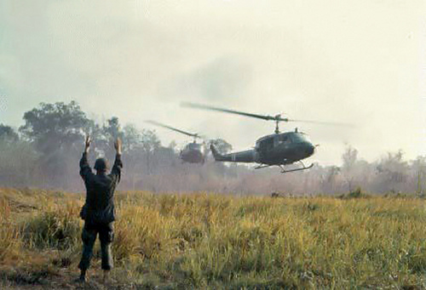
The vietnam war
2.7 million Americans serve – 58,000 died to prevent the fall of South Vietnam to Communism

Slide 2
Cold War Diplomacy
Sec. of State Dulles was critical of the Democrats’ foreign policy
Brinkmanship – President Eisenhower kept a balance
President Eisenhower advocates the CIA overthrowing government in Iran in 1953
In Guatemala, in 1954, the CIA overthrew a leftist government
Soviets suppress Hungarian revolt in 1956
In 1957, Eisenhower pledges support to any Middle Eastern nation resisting communism
Vice President Nixon’s reception in Venezuela in 1958
OPEC formed in 1960

Slide 3
Asia in the Cold War
President Truman gave military aid to the French
China and Soviets aid the Viet Minh
In 1954, French are trapped at Dien Bien Phu and surrender - President Eisenhower refuses to send troops
At Geneva in 1954, France gives up Indochina
SEATO is signed by eight nations in 1954
Vietnam is temporarily divided at the 17th parallel
Election to unify Vietnam are promised
From 1955-1961, the U.S. gives $1 billion to South Vietnam
Eisenhower defends expenditures with “Domino Theory”

Slide 4
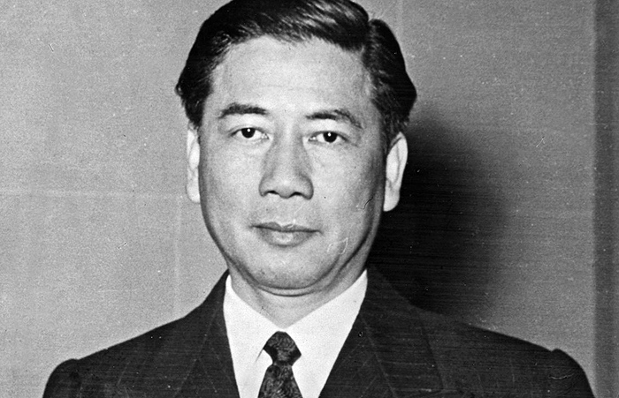
Early Stages
Vietnam was hardly mentioned in the 1960 debates
President Kennedy adopts “Domino Theory”
Kennedy continues military aid to South Vietnam and steadily increases number of “advisers”
By 1963, there are more than 16,000 U.S. troops in South Vietnam creating “strategic hamlets”
South Vietnam’s government under Diem is far from popular
No support from peasants in countryside
Buddhist monks burned themselves in opposition
Diem is assassinated with President Kennedy’s approval

Slide 5
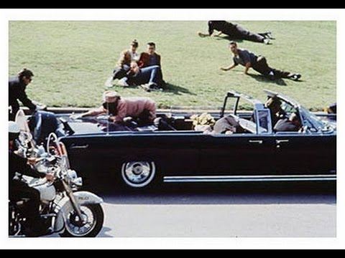
Tonkin Gulf Resolution
As Johnson is sworn in to office things begin to fall apart in South Vietnam
In 1964 presidential election Barry Goldwater attacks Johnson administration for weak policies
In August 1964, President Johnson and Congress take advantage of a naval situation and secure authorization to send in troops – not a war declaration
North Vietnamese gunboats had allegedly fired on U.S. warships in the Gulf of Tonkin
This gave Johnson a blank check to take “all necessary measures” as Commander in Chief

Slide 6
Escalating the War
In 1965, the Vietcong attacks U.S. base at Pleiku
President Johnson authorizes Operation Rolling Thunder – B-52 bombers attack North Vietnam
In April, Johnson uses troops against Vietcong
By end of 1965, there are over 184,000 American troops in South Vietnam – most in combat roles
By end of 1967, there are 486,000 troops in Vietnam and 16,000 had already died there
General Westmoreland says he could “see the light at the end of the tunnel.”

Slide 7
Controversy
“Credibility gap” between administration and the American people
Hawks versus doves
The greatest opposition comes from students on college campuses who would become eligible for the draft upon graduation
In November 1967, Senator Eugene McCarthy challenges President Johnson for the nomination
Tet Offensive – January 1968 – Vietcong attacks against South Vietnam – Americans successfully counter
Tet was a political victory in America as TV viewers witness destruction of the war
LBJ withdraws from the war and the election of 1968

Slide 8
Democratic Convention of 1968
After Robert Kennedy’s assassination in June of 1968, the election became a three-way race:
Democrat Vice President Hubert Humphrey
Liberal who was damaged by Johnson policies
Democratic Governor George Wallace of Alabama
Tapped into southern white racism
Ran as self-nominated candidate for American Independent Party – hoped to throw election into the House of Reps.
Republican Richard Nixon
“Peace with honor. Law and order”
Balanced ticket with Governor Spiro Agnew of Maryland

Slide 9
President Richard Nixon
“Vietnamization”
Gradual withdrawal of American troops
540,000 in 1969 to under 30,000 in 1972
Opposition to President Nixon’s policies:
Expands war in 1970 by bombing Cambodia
Kent State and Jackson State killings
Americans learn of My Lai massacre in 1968
Pentagon Papers released
Kissinger prematurely says “Peace is at hand” in 1972
Paris Accords of 1973 allows American withdrawal

Slide 10
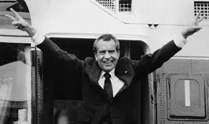
Historical Perspective
America’s longest war - 1964-1973
First in which we failed to achieve objective – a democratic South Vietnam
President Eisenhower had warned of the rise of an American “Industrial Military Complex”
President Johnson sacrificed the “Great Society”
President Nixon grew the credibility gap in America
Watergate and the Saturday Night Massacre
First unelected American president
General William Westmoreland blamed loss on:
restrictions on the conduct of war
American media

