Slide 1
The Allied Drive in Europe
After Pearl Harbor, British, Soviet, and American officials agreed to focus their efforts on Europe.

Slide 2
Response to Pearl Harbor
When Hitler declares war on the United States on December 11, 1941, even Jeanette Rankin declared herself present on the “roll call” vote in Congress.
By Feb. 1942, more than five million Americans had emerged to help in their communities.
Conspiracy rumors circulated in America concerning the Japanese

Slide 3
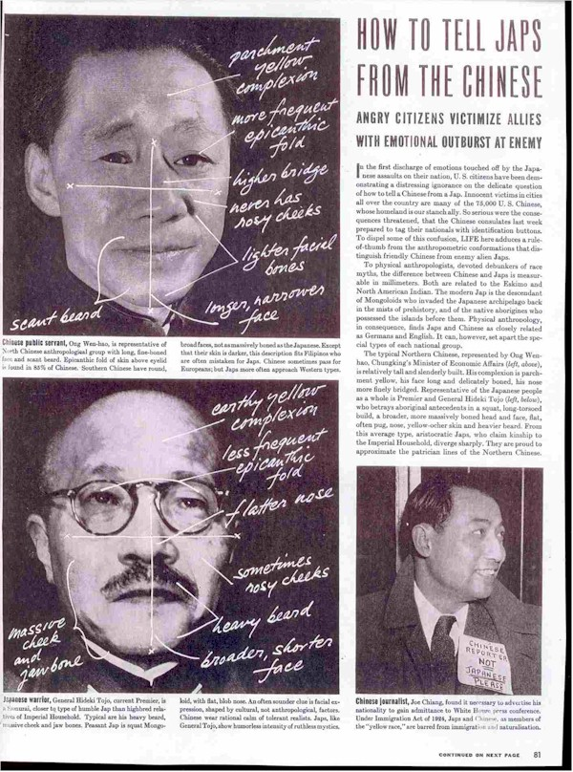
Response to Pearl Harbor
Paranoia was rampant in America:
National Association of Broadcasters banned the playing of requests and weather on the radio
Man-on-the-streets interviews were ended
In a 1941 Time magazine special, subscribers were taught how to distinguish between friendly Chinese and the hated “Japs”
American forces were humiliated at Borneo, Singapore, Wake Island, and the Philippines
American soldiers were forced to strip clothing
In the Philippines, 75,000 American soldiers surrendered – biggest defeat in U.S. history.

Slide 4
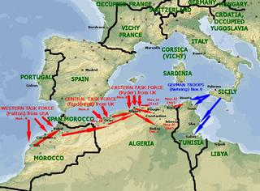
Where to attack first?
Stalin was pressing for another Allied front in the West.
Roosevelt agrees with Churchill that first they must secure the Suez Canal.
In November 1942, Allied forces invade North Africa under General Dwight D. Eisenhower and trap over 250,000 German troops in Tunisia in May 1943.
Meanwhile, the Russians and Germans are fighting at Stalingrad and Leningrad.
Operation torch was the operation where the U.S allied with Great Britain, Took over the French region of north Africa. If successful the operation would serve in containing Hitler's intention in expanding. Control over this region would block critical shipping points to the Mediterranean, as well as provide a kick start for the allies into Italy. It was started on November 8th 1842.

Slide 5
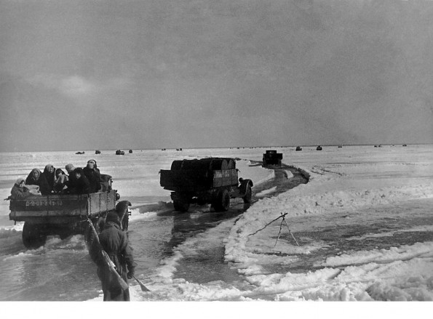
Leningrad
Concerned that an all out assault would be too costly, Hitler decided to blockade the city on its southern border.
By Late December 1941, Leningrad was down to two days’ supply of flour.
53,000 died in December alone.
By February 1942, 200,000 had died
Citizens felled trees in the enemies path and built raid shelters and pillboxes.
They are saved by the “road of life.”
The city was liberated in January1944 – nearly a million people had died – including more civilians than any other city in any war in history.
A view of the ice road during April 1942 when the journey became was even more hazardous as the ice began to melt.

Slide 6
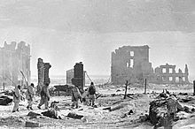
Stalingrad
Hitler wanted access to the oil fields of the Caucasus Mountains
He also understood the symbolism.
This was the essential confrontation Hitler desired – fascism vs. Bolshevism
Germans experienced the legendary Russian resistance at Stalingrad as well.
Oddly imprecise bombing in the north
600 German planes descended on the city one evening with incendiary bombs – 40,000 civilians killed.
The two dictators insisted their armies fight to the death – by radio.
Hitler neglected his flanks and was surrounded – his army trapped in the city – 80,000 German prisoners.

Slide 7
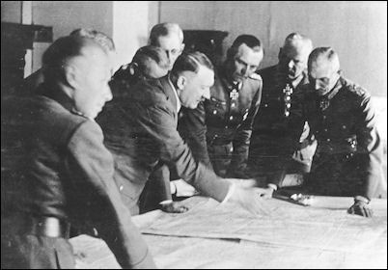
Turning Point
The Battle of Stalingrad ended in January 1943 and marked a turning point.
The Germans would revert to a defensive position.
The highly mobile Blitzkrieg army would, in one year – by 1944, transform into a ponderous, highly immobile army featuring heavy, slow tanks and dug-in infantry.
Hitler had been too greedy in the east and mistakenly declared war on the U.S.

Slide 8
Hitler
Nov. 3, 1943 - Fuhrer Directive No.51
“For the last two and one-half years the bitter and costly struggle against Bolshevism has made the utmost demands upon the bulk of our military resources and energies…The situation has since changed. The threat from the East remains, but an even greater danger looms in the West: the Anglo-American landing! In the East, the vastness of the space will, as a last resort, permit a loss of territory even on a major scale, without suffering a mortal blow to Germany’s chance for survival. Not so in the West! If the enemy here succeeds in penetrating our defense on a wide front, consequences of staggering proportions will follow within a short time. I have therefore decided to strengthen the defenses in the West”

