Slide 1
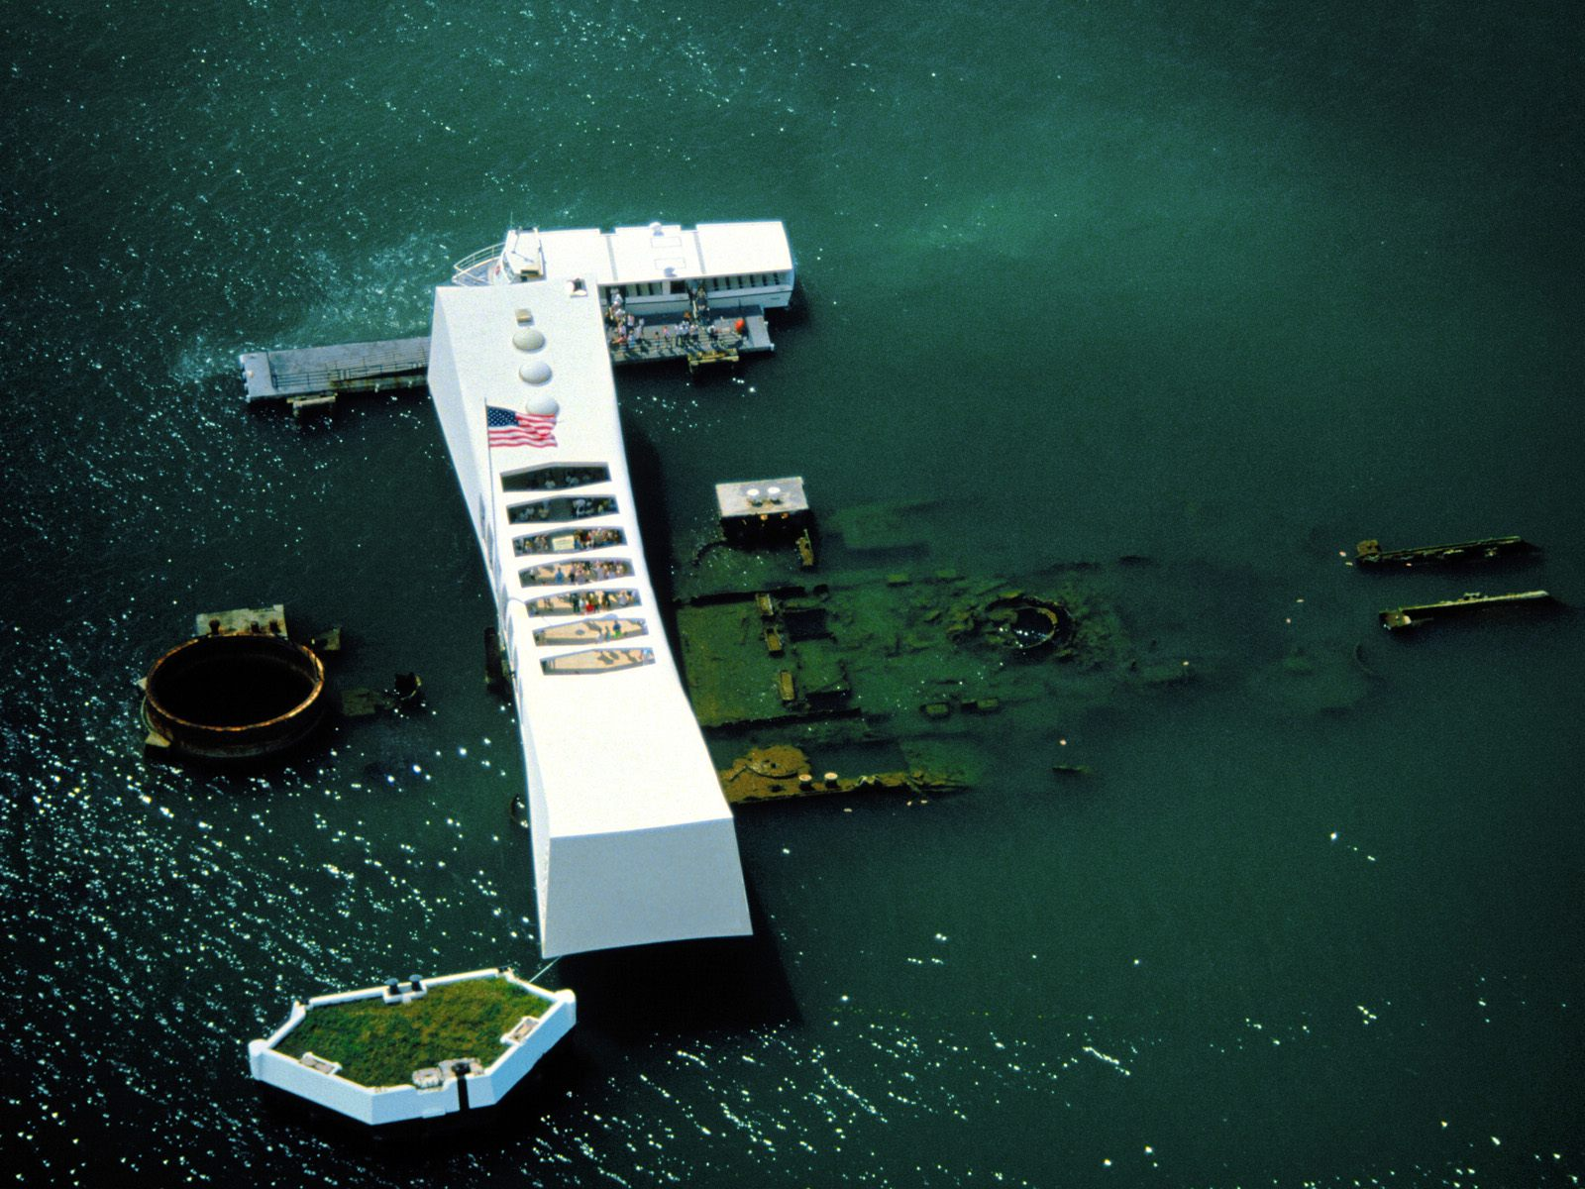
Pearl Harbor – December 7, 1941
“A date which will live in infamy…”
2,400 Americans killed
1,200 Americans wounded
20 warships sunk or damaged
150 airplanes destroyed

Slide 2
Disputes with Japan
Through 1940 and 1941 U.S. relations with Japan are strained:
Invasion of China – Rape of Nanking _1937-38)
Ambitions in Southeast Asia
Allied with Germany and Italy as an Axis power
Roosevelt prohibits export of American steel and scrap iron to all countries except Britain
Japan protests this action as an “unfriendly act”
In July 1941 Japan occupies French Indochina
Roosevelt then completely cuts off the Japanese
Click on the map above to read first-hand of Japanese propaganda in 1940 concerning the Greater East Asia Co-Prosperity Sphere.

Slide 3
Negotiations with Japan
Both sides knew that Japan needed U.S. oil to fuel its navy
Japan had already violated the Open Door in China and was poised to expand further
Roosevelt and Sec. of State Hull insist that Japan withdraw from China – they refuse
Hideki Tojo makes a final attempt at negotiating for oil – neither side yields
Japan believes quick action is necessary in the Pacific and draw up plans for Pearl Harbor

Slide 4
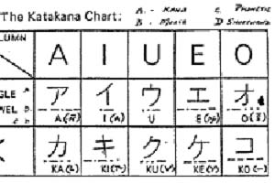
Partial Surprise…
Although the American people are stunned, high government officials knew an attack was coming in the Pacific
Americans had broken the Japanese code, but could not determine when and where the attack would take place
Many officials felt like it would come in the Philippines, Dutch East Indies, or Malaya
On December 8, 1941, Congress declared war with only one dissenting vote
Three days later Germany and Italy declare war on the United States and World War II begins
The Japanese A6M Zero was superior to the U.S. Army P-40 Warhawk. Japanese pilots were wartime veterans of the war in China and embraced an ideology foreign to American pilots.

Slide 5
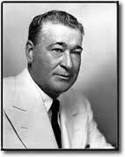
“The Sleeping Giant filled with terrible resolve…”
December 1941 - the battlefront in Europe shifts to the East as Hitler invades the Soviet Union
Churchill, Roosevelt, and Stalin agree to concentrate on the war in Europe first, before shifting resources to the Pacific
As in WWI, the U.S. government organizes agencies to oversee production and consumption
The government uses a cost-plus system for contracting with industry
By 1944, unemployment was practically zero
Henry Kaiser could produce a new ship every 14 days…
Pictured above left: Henry Kaiser became known as the father of modern shipbuilding.
Pictured above right: Andrew Higgins… “The man who won the war,” according to General Eisenhower.

Slide 6
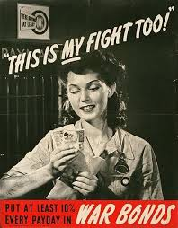
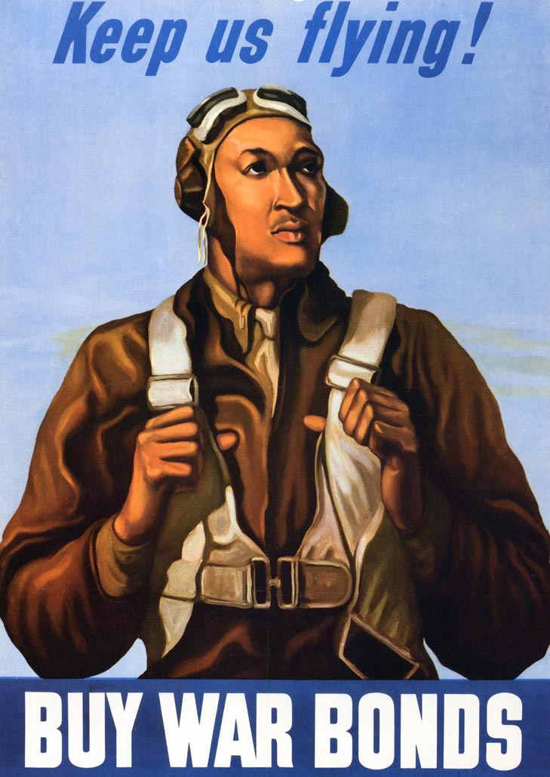
The Home Front…
Financing the war
Government spends $100 billion in 1945 on war
This was funded through an increase in the income tax and selling war bonds
In 1944, the government began withholding taxes from paychecks of American workers
Sold $135 billion in bonds
Also, the shortage of consumer goods made it easier for Americans to save money

