Slide 1
Killing Hitler
Jan. 30, 1933, at noon, Adolf Hitler became the democratically-elected chancellor of Germany… dog whip and all… the Third Reich had begun.

Slide 2
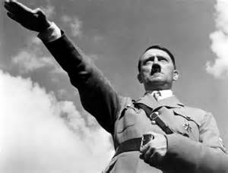
The Fuhrer Principle…

Slide 3
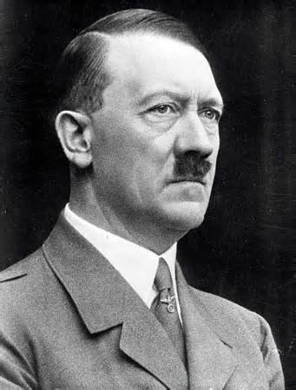
The Fuhrer Principle
Had been around for decades- since early 1900s
Arose out of the German Youth Movement
Hitler insisted on being called “der Fuhrer,” which by definition is:
Self-derived, autocratic, and messianic.
Limitless in authority.
Not subject to any higher power.
“Where books are burned, they will, in the end burn people, too” Heinrich Heine

Slide 4
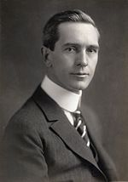
A little perspective…
Mussolini had taken over the government in Rome (1922)
Censored the press, manipulated voting laws, consolidated power
Breckinridge Long (pictured right) served as Ambassador to Italy from 1932-1936:
“…the most interesting experiment in government to come above the horizon since the formulation of our Constitution.”
“The Fascisti in their black shirts… they are dapper and well dressed and stand up straight and lend an atmosphere of individuality and importance to their surroundings.”

Slide 5
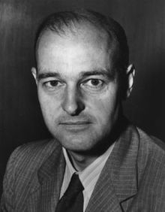
A little bit more…
George Kennan (pictured right), an American diplomat, noted …
“benevolent despotism had greater possibilities for good”
The United States needed to “travel along the road which leads through constitutional change to the authoritarian state.”
Would have a change of heart and after WWII largely shape Truman’s foreign policy… the “Containment Doctrine.”

Slide 6
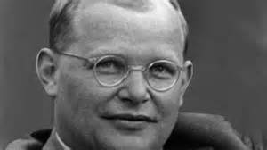
Meet Dietrich Bonhoeffer…

Slide 7
Denouncing Hitler?
Hitler had been in power for only two days.
February 1, 1933, a 26 year old theologian gives a radio address:
Scholarly
Measured and sedate
Logical and precise
Dealt with the fundamental problems of leadership by a Fuhrer:
Inevitably becomes an idol
Inevitably becomes a “mis-leader”
The speech was cut off…
Hitler gives a speech the same day:
“We are determined, as leaders of the nation, to fulfill as a national government the task which has been given to us, swearing fidelity only to God, our conscience, and our Volk.”
Declared to make Christianity the “basis of our morality.”
“May God Almighty take our work into his Grace…
Goebbels records in diary February 3, 1933… “Now it will be easy to carry on the fight, for we can call on all the resources of the State. Radio and press are at our disposal. We shall stage a masterpiece of propaganda…”

Slide 8
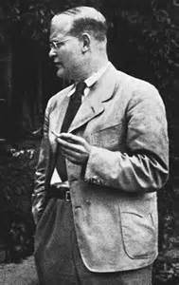
Dietrich Bonhoeffer…
“The true leader must always be able to disillusion… He must radically refuse to become the appeal, the idol… he must let himself be controlled, ordered, restricted.”
“…Thus the Leader points to the office, but Leader and office together point to the final authority itself, before which Reich or state are penultimate authorities. Leaders or offices which set themselves up as gods mock God… and must perish.”

Slide 9
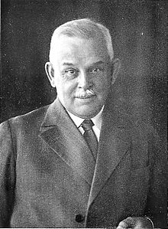
The process…
Arson: burning of the Reichstag – blame on the Communists.
Marinus van der Lubbe was indicted… a communist
Dr. Bonhoeffer testified at trial as an expert in psychology…
Van der Lubbe was eventually beheaded
A martyr for communism
Hitler forces 85 year old Hindenburg to sign the Reichstag Fire Edict, officially suspending the German constitution
Ben Franklin warned us about this situation…

Slide 10
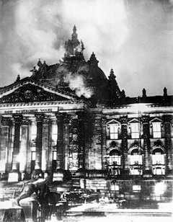
The Process…
“Restrictions on personal liberty, on the right of free expression, including freedom of the press, on the rights of assembly and association, and violations of the privacy of postal, telegraphic and telephonic communications; and warrants for house searches, orders for confiscations as well as restrictions on property, are also permissible beyond the legal limits otherwise prescribed.”
March 23, 1933, the Reichstag passes the Enabling Act, abolishing its own existence, granting Hitler “plenary” power.
April 25, 1933, limits on how many Jewish children could attend public school.
September 29, 1933, Jews are banned from all cultural and entertainment activities… film, theater, literature, and art.
October 1933, Jews banned from the world of journalism.

Slide 11
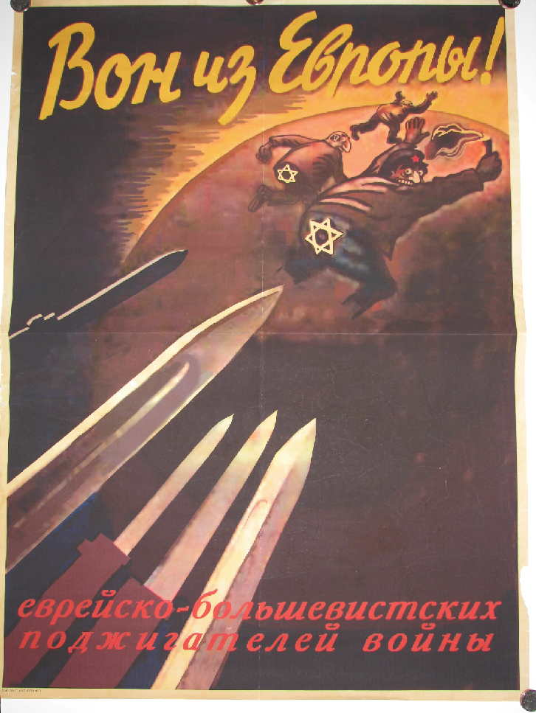
“The Church and the Jewish Question”
One week after passing the Enabling Act, Hitler responds with a boycott of Jewish stores across Germany
Jewish doctor and lawyer offices were targeted as well
“Germans, Protect Yourselves! Don’t buy from Jews!”
“Germans, Defend Yourselves from Jewish Atrocity Propaganda!”
Pictured right… “Get the Jewish-Bolshevist Warmongers Out of Europe!”

Slide 12
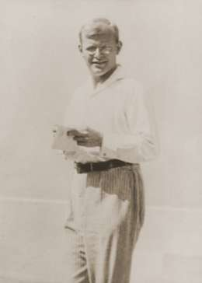
“The Church and the Jewish Question”
The “Aryan Paragraph” went into effect April 7, 1933, pursuant to the goal of “Gleichschaltung,” or synchronization.
Government employees had to be of Aryan stock
Anyone of Jewish decent would be fired immediately
This would apply to the German church, essentially a state church
The Church was in turmoil
Dietrich Bonhoeffer responds with an essay entitled “The Church and the Jewish Question”
Bonhoeffer said that the true Church must stand with the Jews, and NOT adopt the Aryan Paragraph… there was a resulting split in the church between the Reichskirche and the Confessing Church (May 1934)

Slide 13
The Choice…
The Pastor’s Emergency League (1933):
Rededication to Scripture
Protection of the fidelity to Scripture
Assistance to those persecuted
Refutation of the Aryan Paragraph
6,000 pastors signed into this league!!!
“First they came for the Socialist, and I did not speak out… Then they came for the Trade Unionists… then they came for the Jews… And then they came for me – and there was no one left to speak for me.”
Martin Niemoller from prison
“It has become ever more evident to me that we are to be given a great popular national Church, whose nature cannot be reconciled with Christianity, and that we must prepare our minds for the entirely new paths which we shall then have to follow. The question is really: Christianity or Germanism? And the sooner the conflict is revealed in the clear light of day the better.”
Friends encouraged him to join the state church to work against it from within… subversively… to which he responded…
“If you board the wrong train it is in no
use running along the corridor in the
opposite direction.” Dietrich Bonhoeffer

Slide 14
Stauffenburg…
By 1943, some conspirators were tipped off that Hitler was onto them
Feared another Night of the Long Knives taking place some time soon

