Slide 1
FDR’s Alphabet Soup
By Caroline Duncan and Felicity Meadows, 6th Period

Slide 2
Summary
When Roosevelt took office in 1933 he created a bunch of organizations in his first 100 days as President. They became known as his “Alphabet Soup” because they were known by acronyms. A lot of people didn’t agree with his decision to create so many programs and interfere with the economy, so they poked fun at his attempts to get the country out of depression. Some of his programs, though, were good ideas and are still in use today, but others failed miserably.
“What the New Deal showed is that the [federal] government could make a difference. The government could improve people's lives during terrible times and it could make an enormous difference in people's lives.” - Representative Steve Cohen

Slide 3
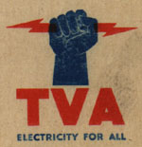
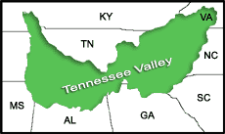
TVA: Tennessee Valley Authority
Created in May 1933
Exploited resources led to soil erosion and massive floods
Program created to build 20 new dams and teach soil management
FDR wanted “a corporation clothed with the power of government but possessed of the flexibility and initiative of a private enterprise.”
Power created was sold to the public at low prices, which angered A lot of private companies
One of the seven New Deal programs still in effect
America’s largest public power company

Slide 4
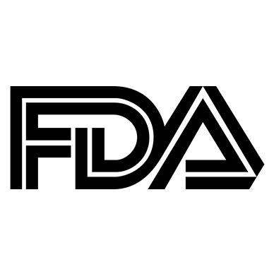
FDA: Food and Drug Administration
Packaging, inspections, and regulations
Originated as early as 1862 under Abraham Lincoln but got it’s name under FDR in 1930
Charles M. Wetherill
Bureau of Chemistry
Pure Food and Drugs Act 1906
FDC Act 1930
Continues to pass laws and acts to this day

Slide 5
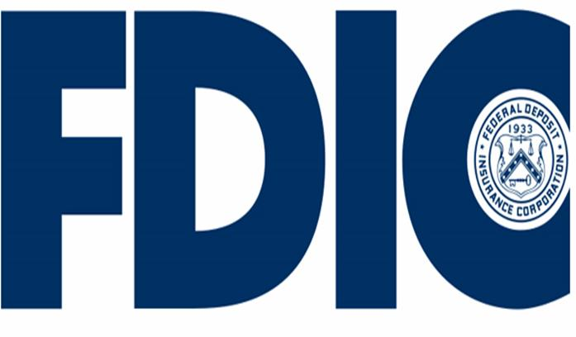
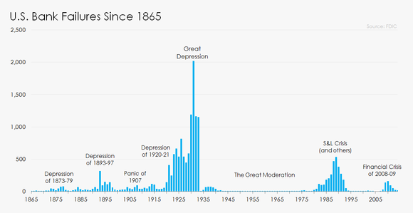
FDIC: Federal Deposit Insurance Corporation
Protects the money you deposit into the bank
In case of a bank failure, this corporation made sure all of your saving weren’t lost.
Created by the Banking Act of 1933, aka the Glass-Stegall Banking Act
Gave authority to the FDIC to provide deposit insurance to banks
FDIC can regulate and supervise nonmember banks
The chart to right displays how bank failures decreased greatly after issuing the FDIC.

Slide 6
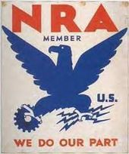
NRA: National Recovery Administration
Purpose- To eliminate antitrust laws so that companies wouldn't have unnecessary competition and, ultimately, to raise profits.
Created artificial commodity scarcity
Made tons of laws that regulated labor
Had to avoid charges of Socialism
Did not have a very positive effect on the economy
Protected big business but overlooked the consumer
Was deemed unconstitutional in 1963
Modern NRA has nothing to do with this program
The emblem of the NRA displayed by companies that supported them

Slide 7
SEC: Securities and Exchange Commission
Established in 1934 after the investigation of the New York Stock Exchange
“The commission’s purpose was to restore investor confidence by ending misleading sales practices and stock manipulations that led to the collapse of the stock market in 1929.” Encyclopedia Britannica
Registration and supervision, proxy rules, unfair use of nonpublic information
Proxies
Advisor to the court for bankruptcy cases

Slide 8
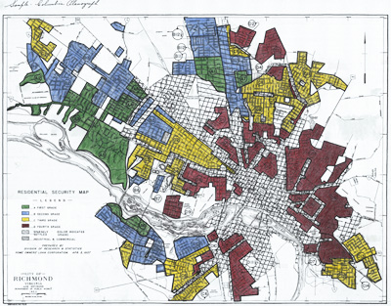
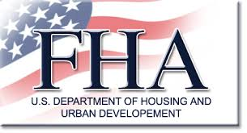
FHA: Federal Housing Authority
Established by National Housing Act of 1934
To regulate interest and mortgages after the bank crisis of the 30’s
Restricted to whom it gave loans
Based on location and racial/ethnic composition of the neighborhood
The Underwriting Handbook
Required to cover unpaid balances
Part of the Department of Housing and Urban Development
Only completely self-funded government agency

Slide 9
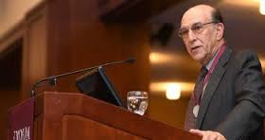
Richard Rothstein on the FHA
Research associate at the Economic Policy Institute
Studied the history of American racial segregation
On the FHA
Most effective in segregating metropolitan areas
Financed mass production
Gave builders loans on the condition that they prohibited African Americans from their neighborhoods
Not in favor of the FHA

Slide 10
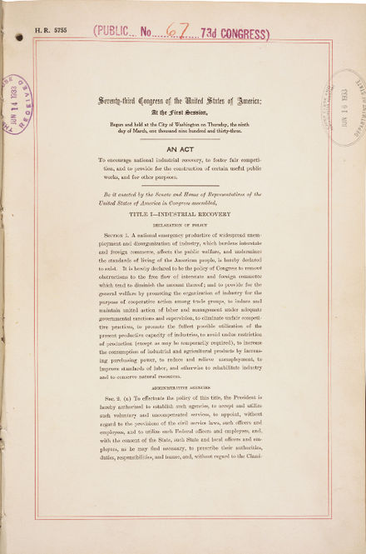
PWA: Public Works Administration
Created June 16, 1933, by the National Industrial Recovery Act (NIRA)
According to The Eleanor Roosevelt Paper Project, the purpose of the PWA was to spend “ big bucks on big projects.”
Reduced unemployment and encouraged economic growth
Highways, buildings, housing, energy, flood control, and more public works
FDR made the war a greater priority, which led to the end of the PWA
FDR’s executive order of July 1st, 1943 “All functions, powers, and duties of the Public Works Administration and of the Commissioner of Public Works are hereby transferred to the office of the Federal Works Administrator.”- Primary Source

Slide 11
FCC: Federal Communications Commission
Created in 1934 by the Communications Act
Main purpose was to regulate all forms of communications in the United States
Still in effect today
The FCC has four main goals:
To promote economic growth and national leadership
To protect public interests goals
To make networks work for everyone
To promote operational excellence
In the 1960’s, the FCC was involved in creating the Internet.

Slide 12
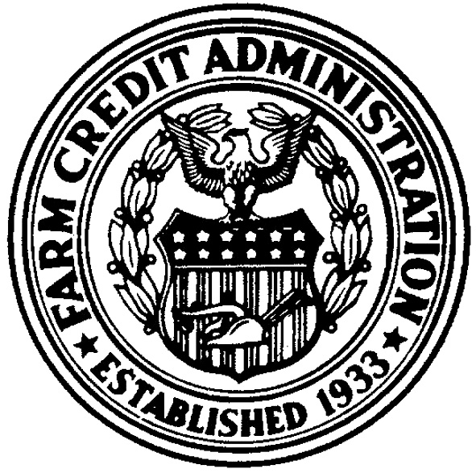
FCA: Farm Credit Administration
Established in 1933
Purpose was to provide farmers with a dependable credit source
Expanded agricultural credits
Oversees all banks that grants credit to farmers that were set up under the Farm Credit Act of 1916.
The modern day FCA now gets authority from the 1971 Farm Credit Act

Slide 13
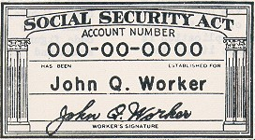
SSA: Social Security Administration
Created by the Social Security Act of 1935
Purpose was to provide money for people who were unable to work because they were old, disabled, or unemployed.
Also under this act, social security tax was created, which is used to pay for the Social Security Administration program.
Unemployment insurance and monthly retirement benefit both helped pay for the SSA.
Still in effect today, however, it is now known as the Federal Security Agency (FSA).

Slide 14
Sources
The Editors of Encyclopædia Britannica. "National Recovery Administration (NRA)." Encyclopædia Britannica. Encyclopædia Britannica, Inc., 20 July 1998. Web. 13 Feb. 2017.
"FDR's Alphabet Soup." Ushistory.org. Independence Hall Association, n.d. Web. 13 Feb. 2017.
"Federal Deposit Insurance Corporation." FDIC: Historical Timeline. N.p., n.d. Web. 13 Feb. 2017.
"Federal Deposit Insurance Corporation (FDIC), 1933-present." Living New Deal. N.p., n.d. Web. 13 Feb. 2017.
"A Guide to Banking Reform and Narrow Banking." Narrow Banking. N.p., n.d. Web. 13 Feb. 2017.
"The 1930s." TVA - The 1930s. N.p., n.d. Web. 13 Feb. 2017.
"Tennessee Valley Authority (TVA)." Tennessee Valley Authority (TVA). N.p., n.d. Web. 13 Feb. 2017.
"Public Works Administration (PWA), 1933-1943." Living New Deal. N.p., n.d. Web. 13 Feb. 2017.
"Public Works Administration." Public Works Administration. N.p., n.d. Web. 13 Feb. 2017.
Alchin, Linda. "Social Security Act of 1935." Social Security Act of 1935: US History for Kids ***. Siteseen Ltd, n.d. Web. 13 Feb. 2017
"Social Security." Social Security History. N.p., n.d. Web. 13 Feb. 2017.
"Farm Credit Administration." West's Encyclopedia of American Law. Encyclopedia.com, n.d. Web. 13 Feb. 2017.
"The History of the Federal Communications Commission (FCC) | ShoreTel." The History of the Federal Communications Commission (FCC) | ShoreTel. N.p., n.d. Web. 13 Feb. 2017.

Slide 15
Sources (cont.)
"Inspection Fact Sheet." Federal Communications Commission. N.p., 16 Nov. 2015. Web. 13 Feb. 2017.
"FDA History – Timeline of Agency's Milestones & New Regulations." DrugWatch. N.p., n.d. Web. 13 Feb. 2017.
"When and Why Was FDA Formed?" When and Why Was FDA Formed? N.p., n.d. Web. 13 Feb. 2017.
The Editors of Encyclopædia Britannica. "Securities and Exchange Commission (SEC)."Encyclopædia Britannica. Encyclopædia Britannica, Inc., 11 June 2010. Web. 13 Feb. 2017.
"1934: Federal Housing Administration Created." 1934: Federal Housing Administration Created. N.p., n.d. Web. 13 Feb. 2017.
"Public Works Administration." Public Works Administration. N.p., n.d. Web. 13 Feb. 2017.
"Franklin D. Roosevelt: Executive Order 9357 Transferring the Functions of the Public Works Administration to the Federal Works Agency." Franklin D. Roosevelt: Executive Order 9357 Transferring the Functions of the Public Works Administration to the Federal Works Agency.N.p., n.d. Web. 13 Feb. 2017.
"Historian Says Don't 'Sanitize' How Our Government Created Ghettos." NPR. NPR, n.d. Web. 14 Feb. 2017.
"New Deal or Raw Deal?" CNN. Cable News Network, n.d. Web. 14 Feb. 2017.

Slide 16
Sources
Alchin, Linda. "Social Security Act of 1935." Social Security Act of 1935: US History for Kids ***. Siteseen Ltd, n.d. Web. 13 Feb. 2017
"Social Security." Social Security History. N.p., n.d. Web. 13 Feb. 2017.
"Farm Credit Administration." West's Encyclopedia of American Law. Encyclopedia.com, n.d. Web. 13 Feb. 2017.
"The History of the Federal Communications Commission (FCC) | ShoreTel." The History of the Federal Communications Commission (FCC) | ShoreTel. N.p., n.d. Web. 13 Feb. 2017.

Slide 17
Review Questions:
Which New Deal agency/organization set up a retirement system for the older workers?
SSA
PWA
TVA
FCA
The PWA’s main purpose was to…
Provide farmers with a dependable credit source
Spend big bucks on big projects
Eliminate antitrust laws
Regulate interests and mortgages
Which agency led in the number of bank failures to drop after the Great Depression?
FCA
SEC
FCC
FDIC
Which one of the following is not one of the goals of the Federal Communications Commission (FCC)?
Promote economic growth and national leadership
Protect public interest goals
Investing in the development of telephones
Promote operational excellence

Slide 18
Review Questions:
The modern day Farm Credit Administration (FCA) gets their authority from the 1933 Farm Credit Act.
True
False
The NRA is still a part of our government today, but it’s purpose has changed
True
False
Which states were the Tennessee Valley Authority intended to affect?
Only Tennessee
Tennessee and Arkansas only
All 50 states
Kentucky, Tennessee, Virginia, North Carolina, South Carolina, Georgia, Alabama, and Mississippi
When did the FDA get its earliest start?
1830 under Andrew Jackson
1862 under Abraham Lincoln
1930 under FDR
1945 under FDR

Slide 19
Review Questions
What is a proxy?
An agency or office that acts as a substitute for another
A company that makes false stock advertisements
Anyone that fails to pay up for their stock money owed
A nickname for the stock exchange
Which of the following is not true of the FHA?
It is the only self funded government agency
It was created to regulate mortgages and interest
It helped cause the banking crisis of 1930
It is still a part of the Department of Housing and Urban Development

